Slide 1
BANK LOAN CASE STUDY
-final project-2

Slide 2
PROJECT DESCRIPTION:
The project is all about analyzing bank loan application data and drawing meaningful insights from it.The success of a loan application, as defined by its approval and repayment status, is crucial for financial institutions.
Understanding factors such as customer attributes, loan amount, credit history, and repayment behavior can provide valuable insights for better decision-making in loan approvals.
The project data is given in an Excel sheet, which should be cleaned and made ready for analysis.

Slide 3
TECH STACK USED:
SOFTWARE: MICROSOFT EXCEL:
I used microsoft EXCEL to perform the excel operations.EXCEL is a powerful for working on data having rows and columns.
OPERATING SYSTEM: MacOS
My device is MacOs.I have used it as it is stable and efficient.

Slide 4
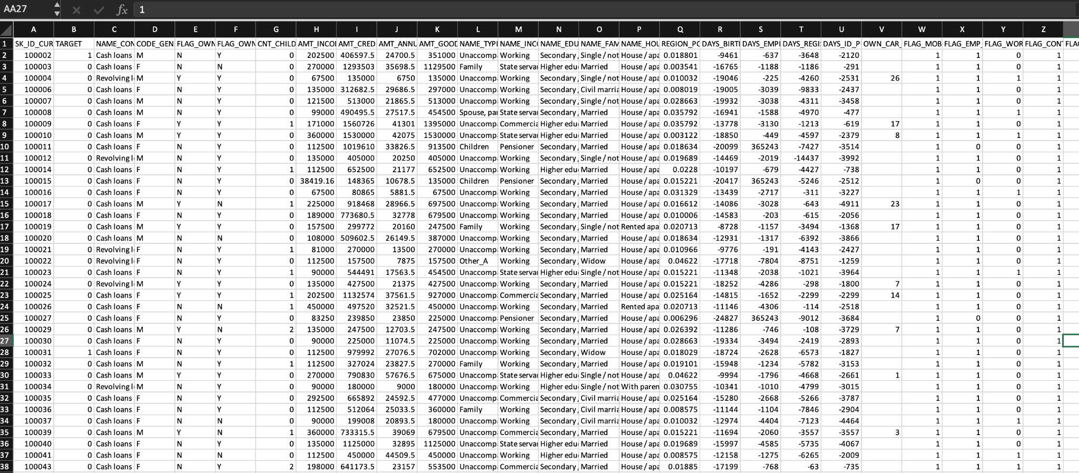
RAW DATA:
The team has given has DR(122) columns and 50,000 records in excel to work.

Slide 5
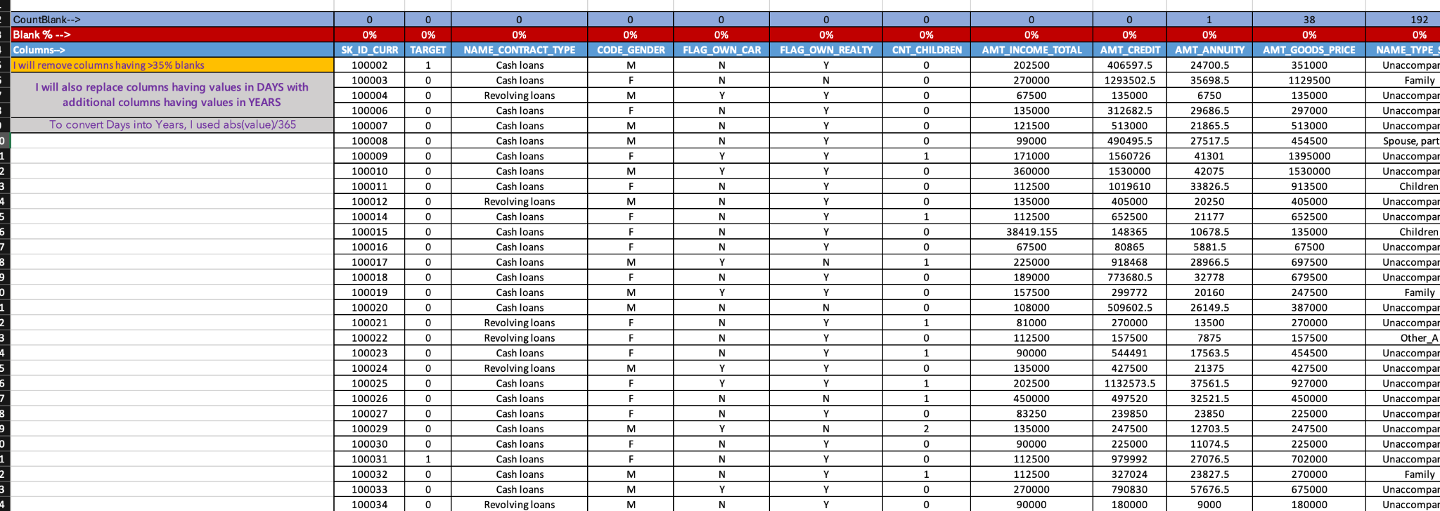
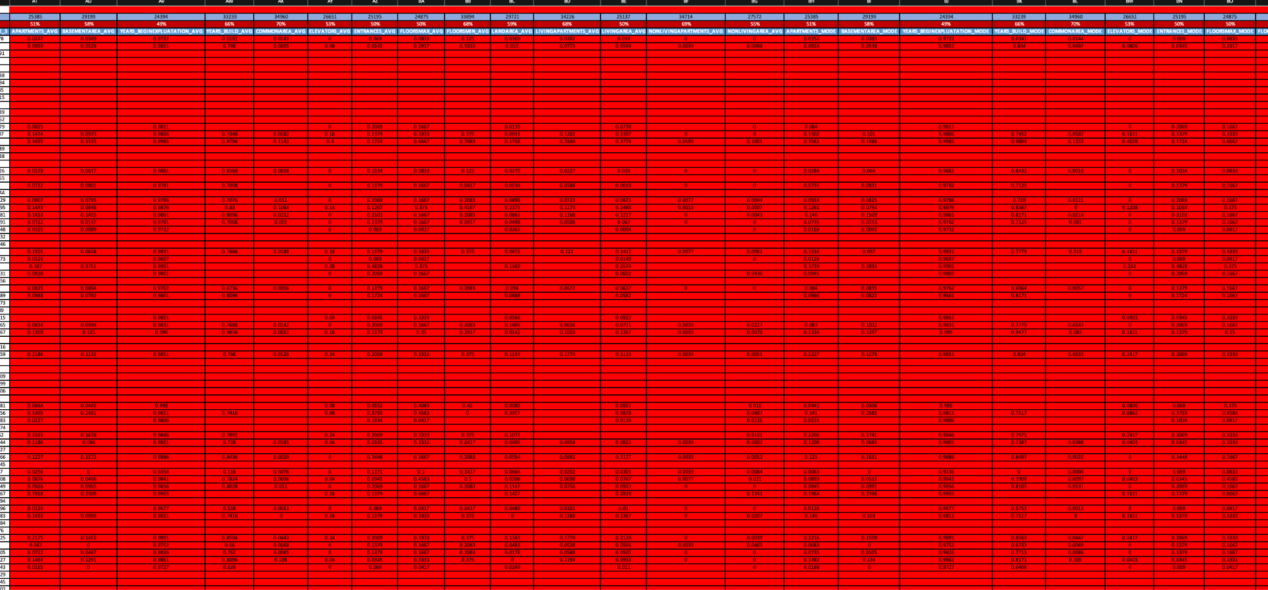
DATA ANALYTIC TASKS:
A. Identify Missing Data and Deal with it Appropriately:
Identify the missing data in the dataset and decide on an appropriate method to deal with it using Excel built-in functions and features.

Slide 6
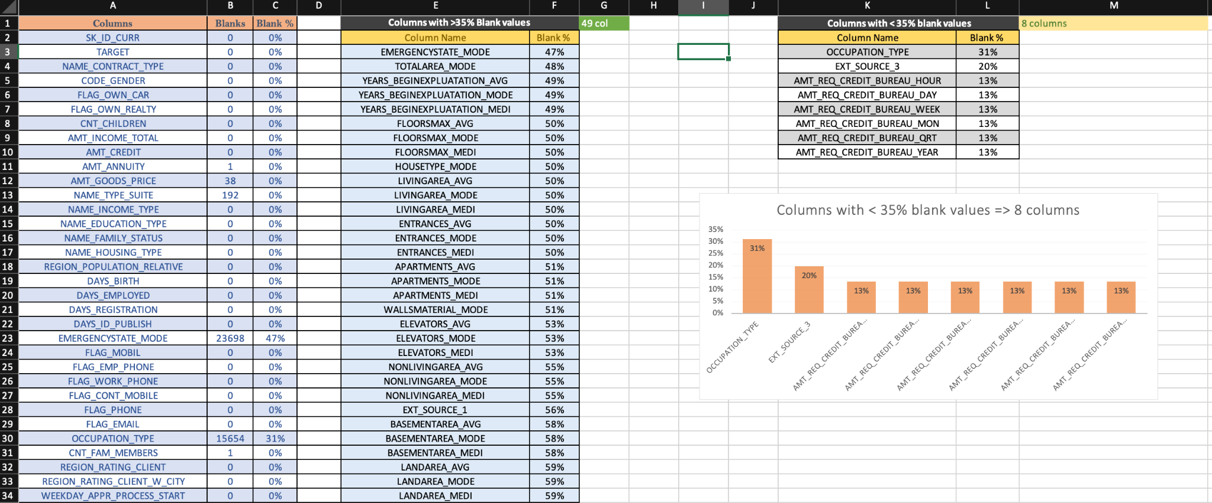
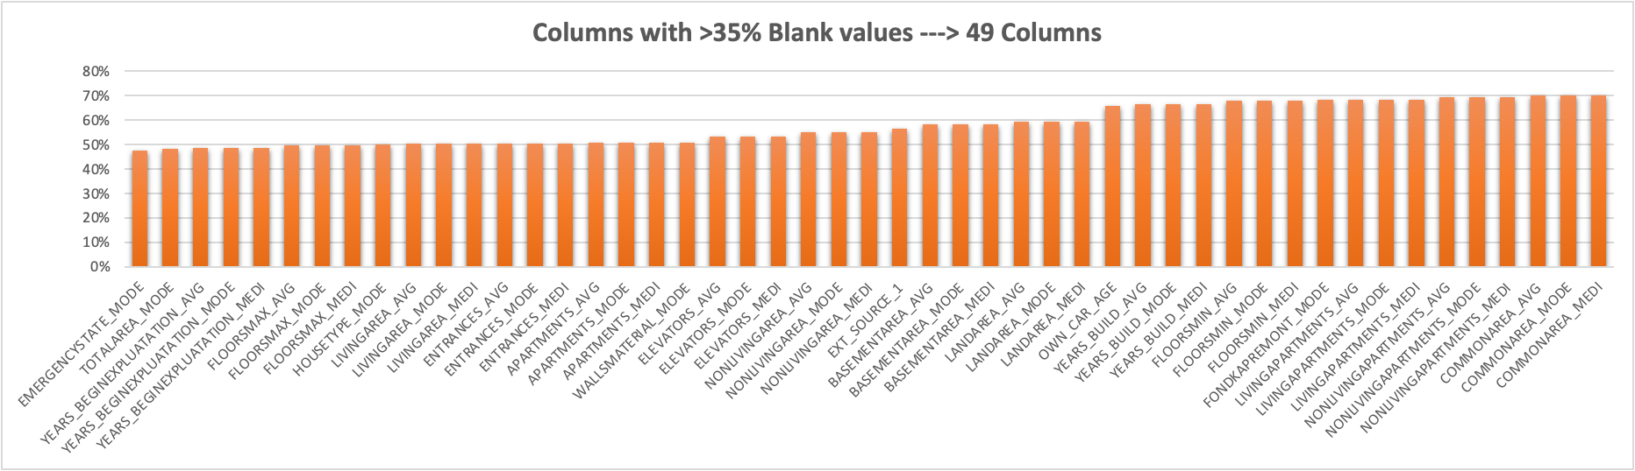
DATA ANALYTIC TASKS:
A. Identify Missing Data and Deal with it Appropriately:

Slide 7
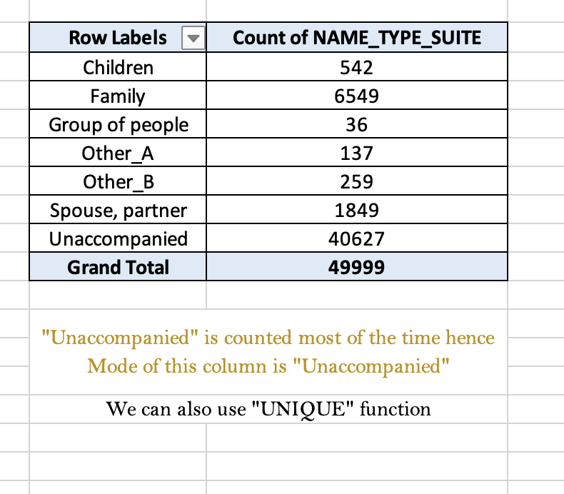
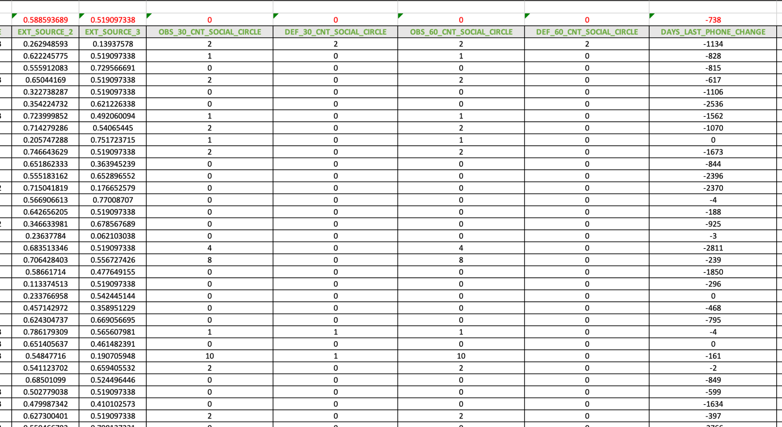
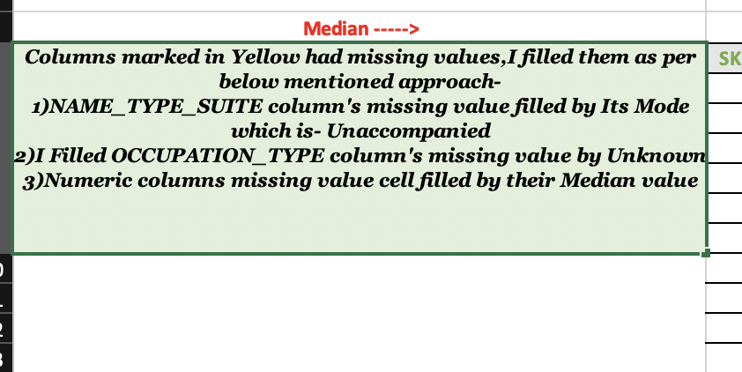
DATA ANALYTIC TASKS:
A. Identify Missing Data and Deal with it Appropriately:

Slide 8
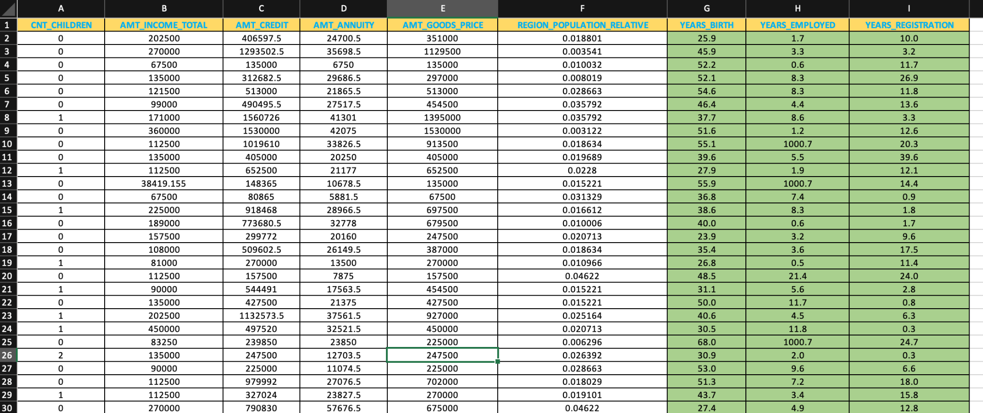
DATA ANALYTIC TASKS:
B. Identify Outliers in the Datasets:
Outliers can significantly impact the analysis and distort the results. You need to identify outliers in the loan application dataset.

Slide 9
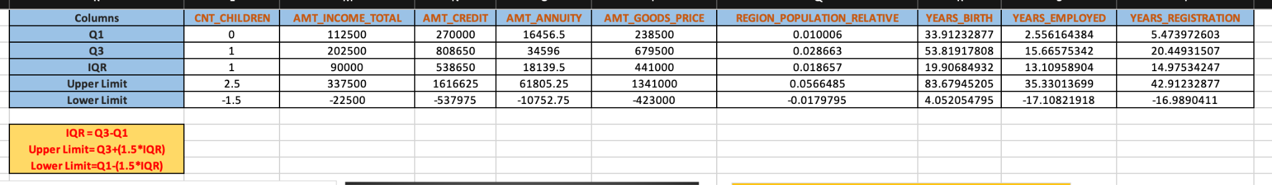
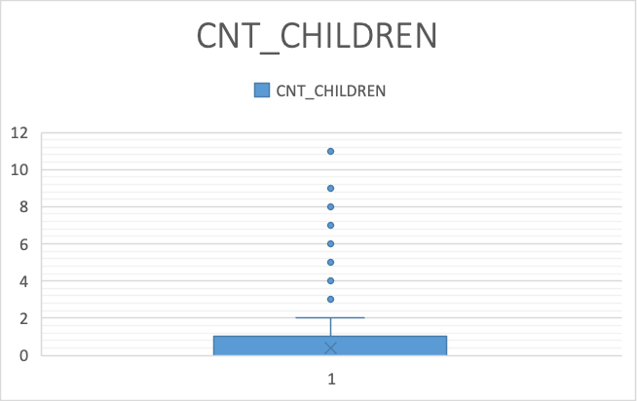
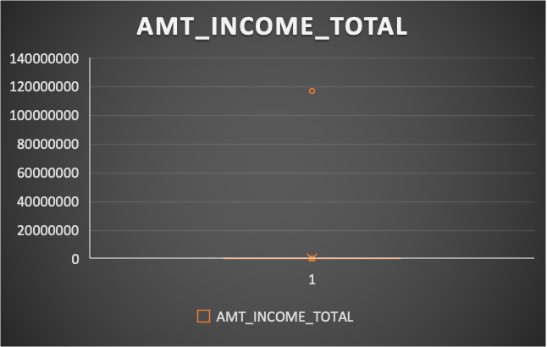
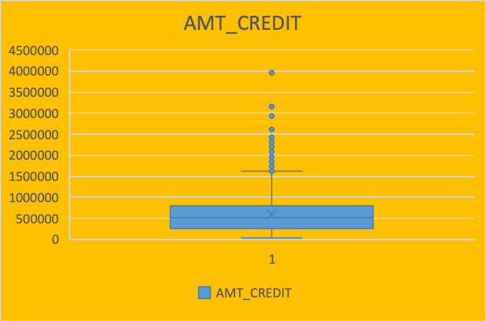
DATA ANALYTIC TASKS:
B. Identify Outliers in the Datasets:

Slide 10
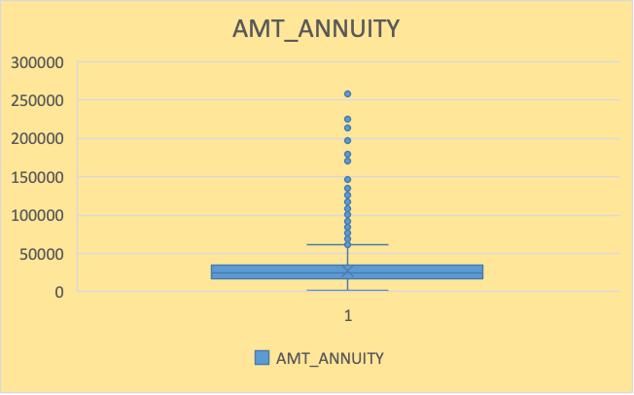
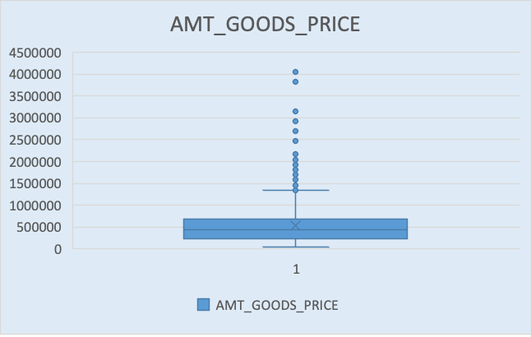
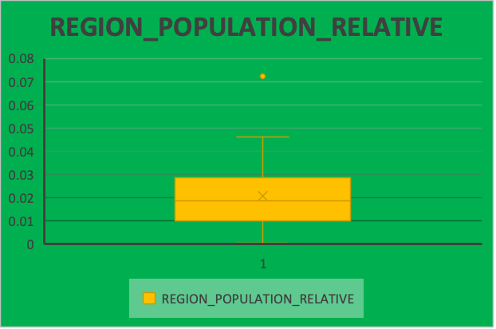
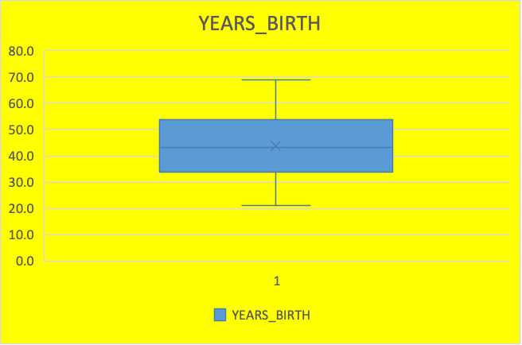
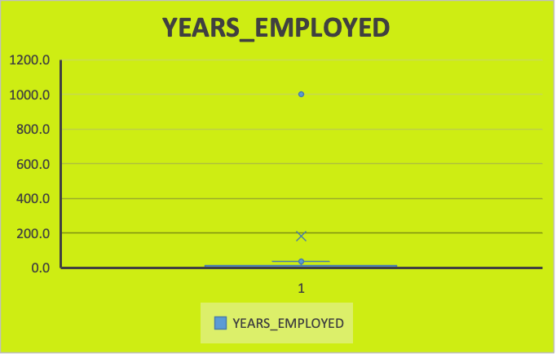
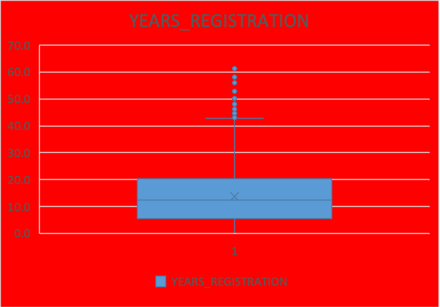
DATA ANALYTIC TASKS:
B. Identify Outliers in the Datasets:

Slide 11
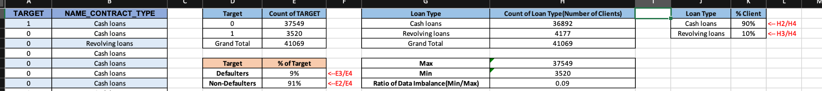
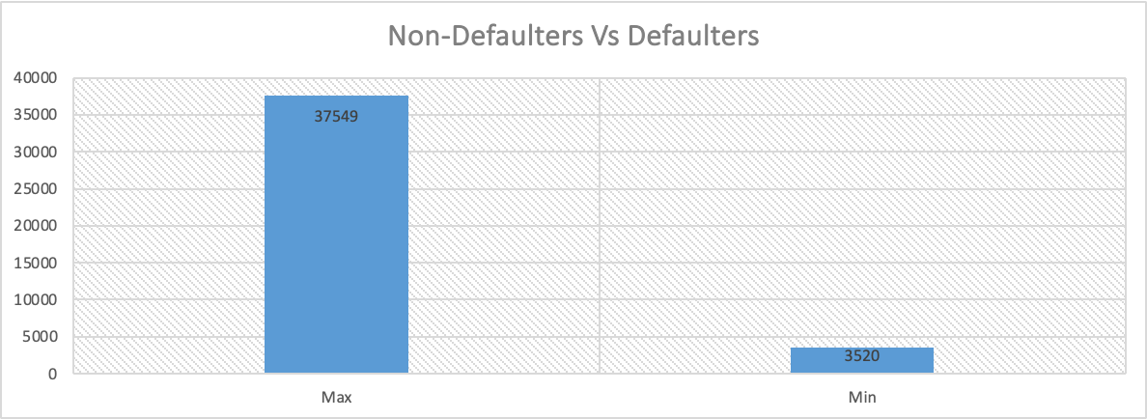
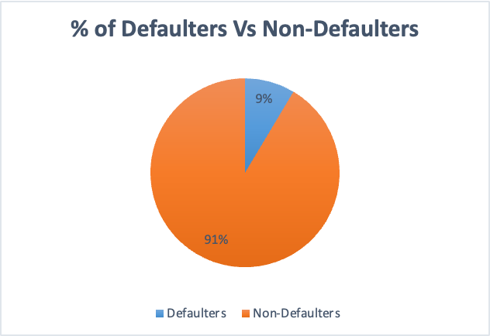
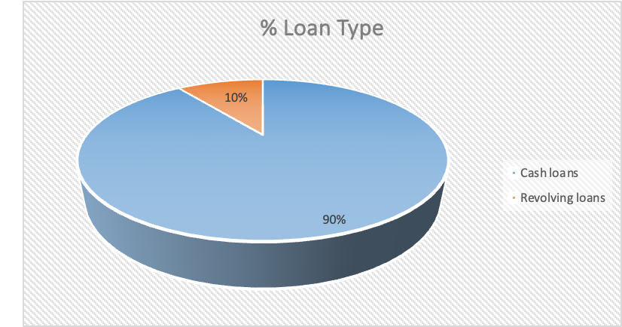
DATA ANALYTIC TASKS:
C.Analyze Data Imbalance:
Determine if there is data imbalance in the loan application dataset and calculate the ratio of data imbalance using Excel functions.

Slide 12
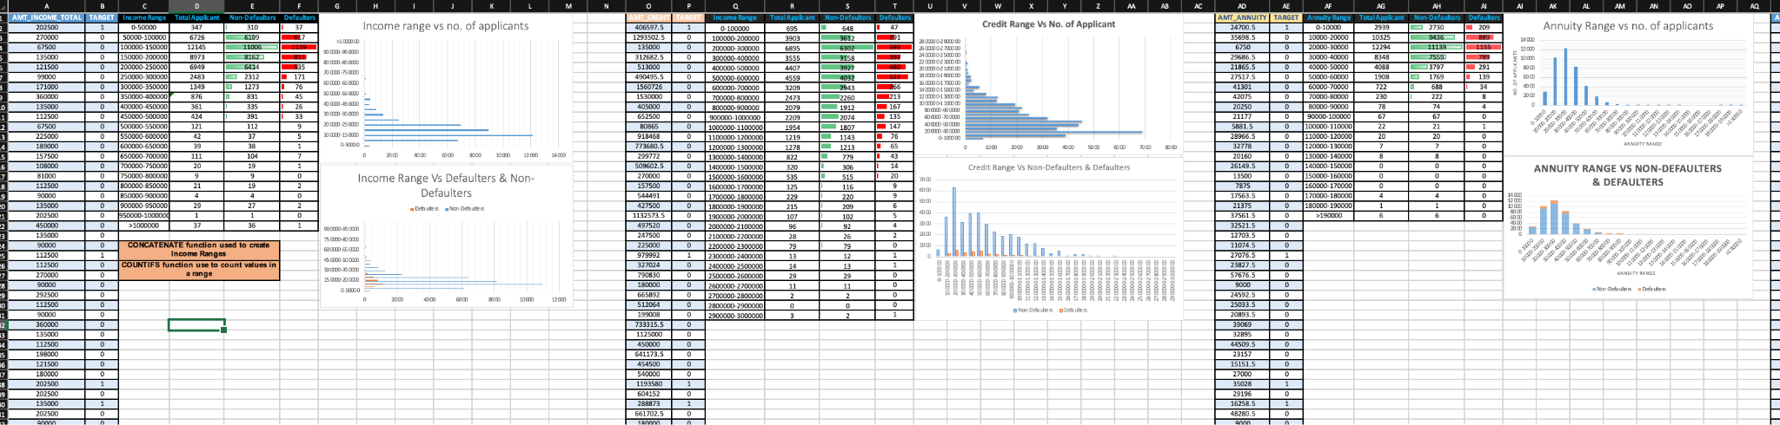
DATA ANALYTIC TASKS:
D. Perform Univariate,Segmented Univariate, and Bivariate Analysis:
Perform univariate analysis to understand the distribution of individual variables, segmented univariate analysis to compare variable distributions for different scenarios, and bivariate analysis to explore relationships between variables and the target variable using Excel functions and features.
SEGMENTED UNIVARIATE ANALYSIS:

Slide 13
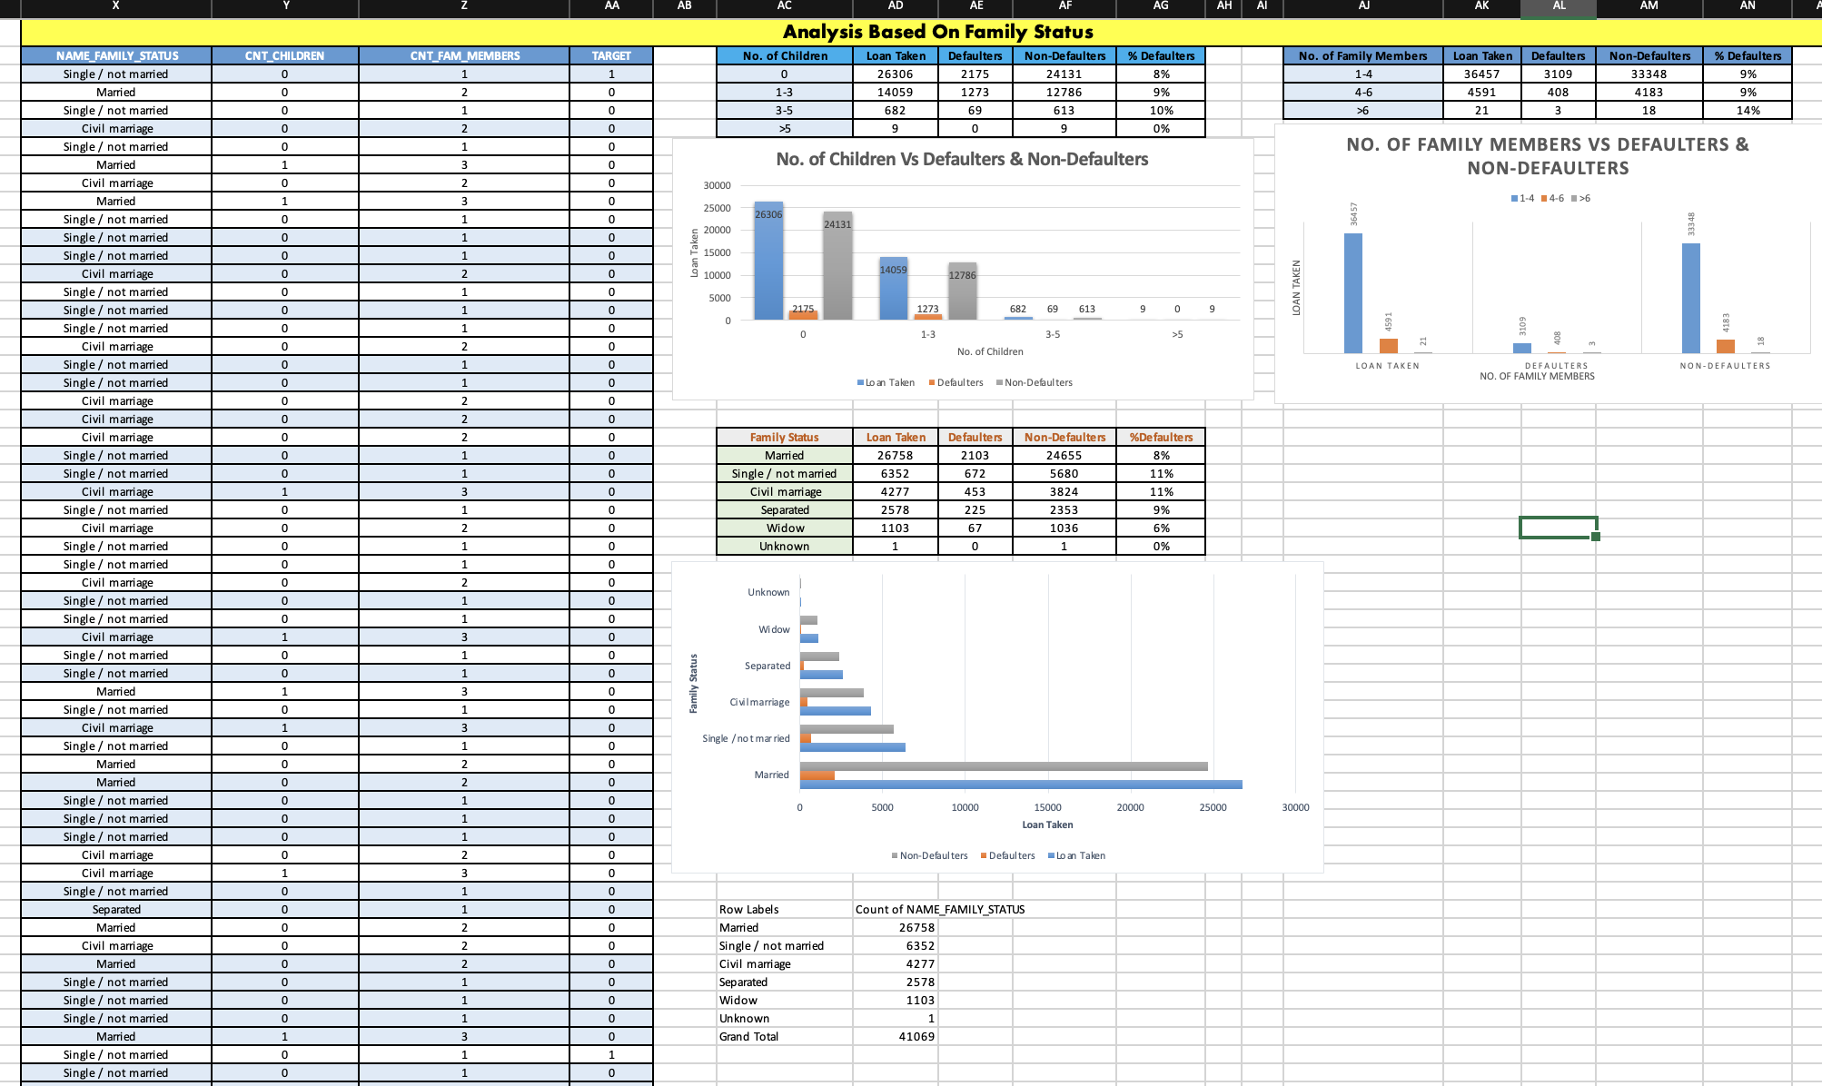
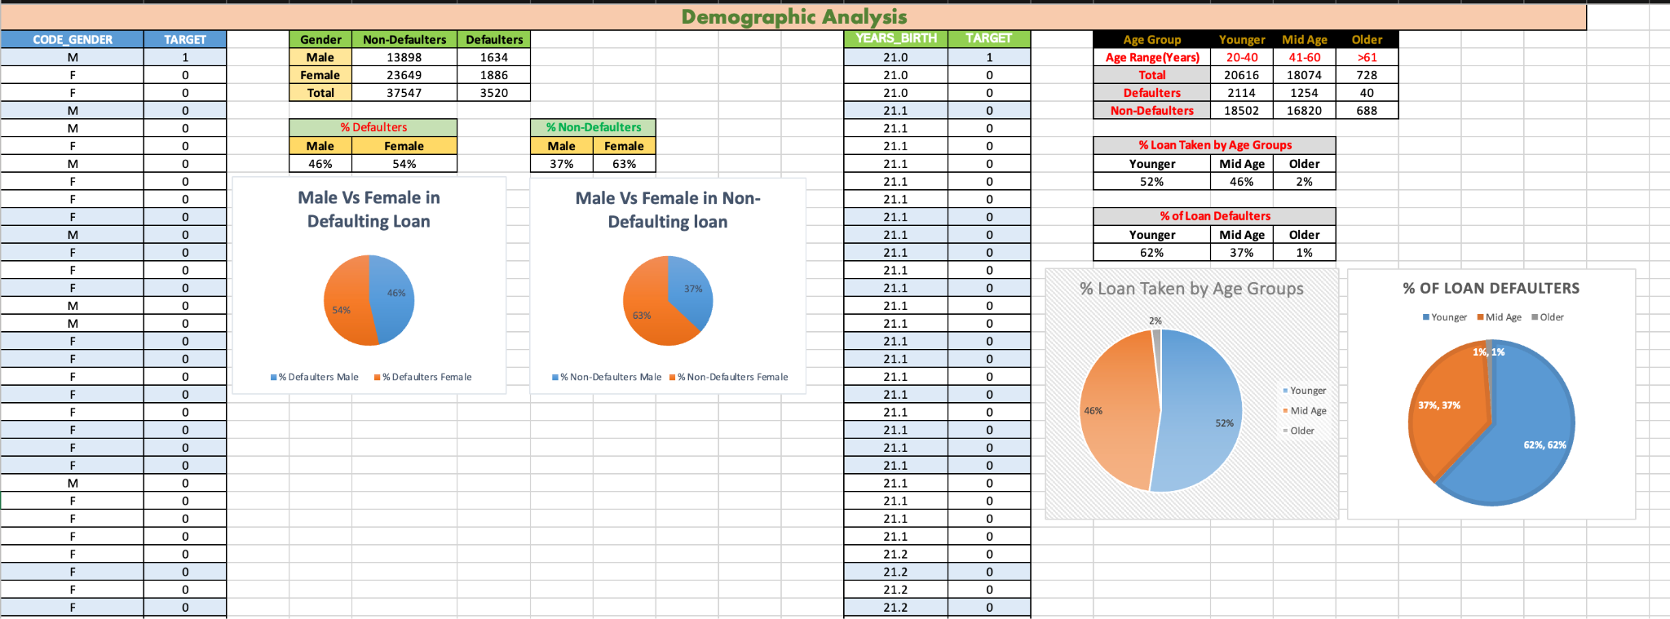
DATA ANALYTIC TASKS:
D. Perform Univariate,Segmented Univariate, and Bivariate Analysis:
UNIVARIATE ANALYSIS:

Slide 14
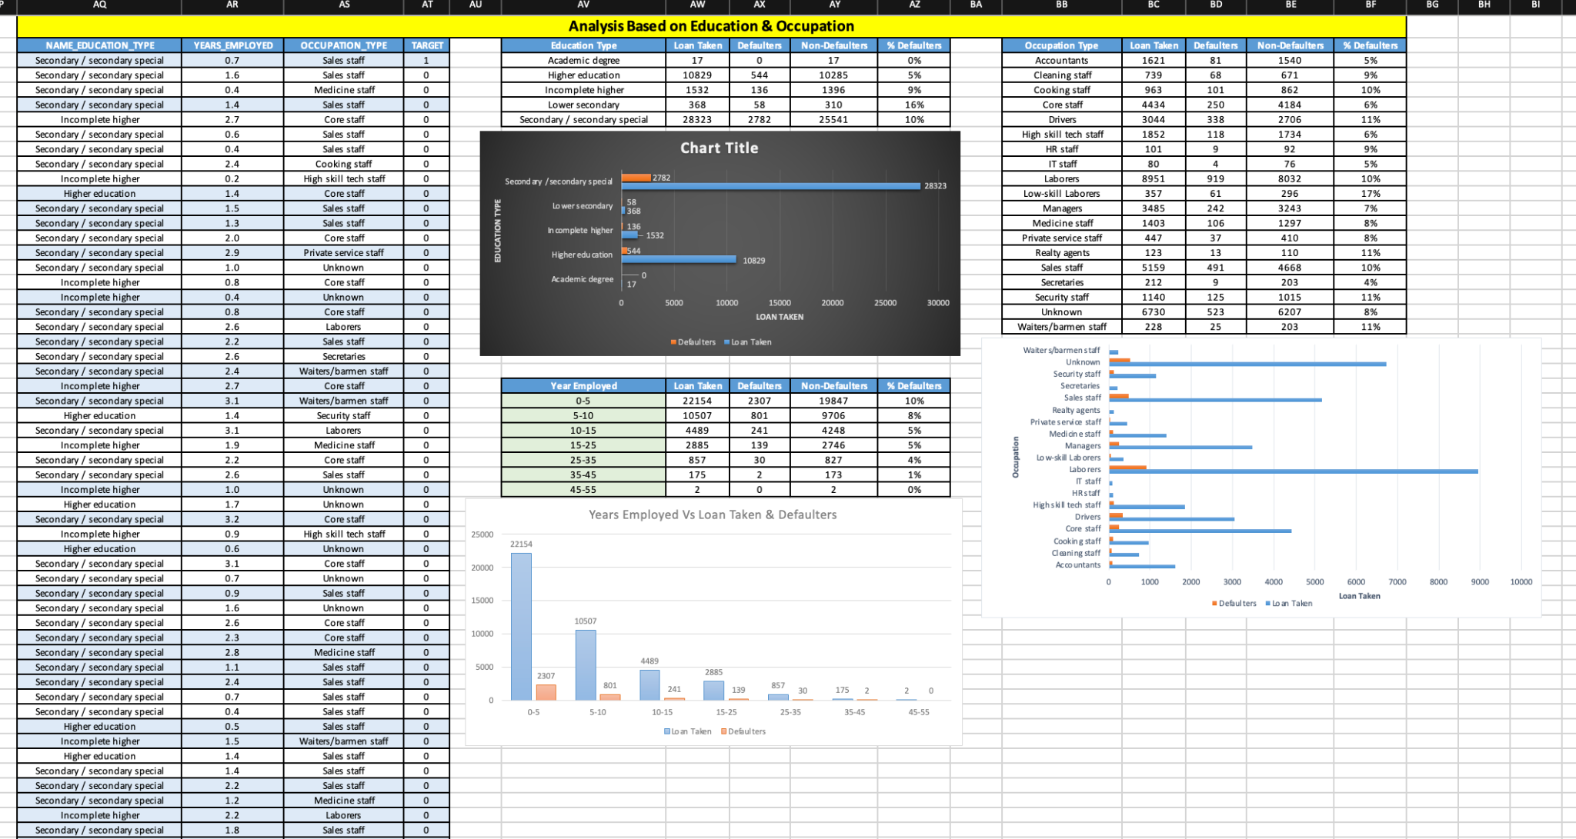
DATA ANALYTIC TASKS:
D. Perform Univariate,Segmented Univariate, and Bivariate Analysis:
UNIVARIATE ANALYSIS:

Slide 15
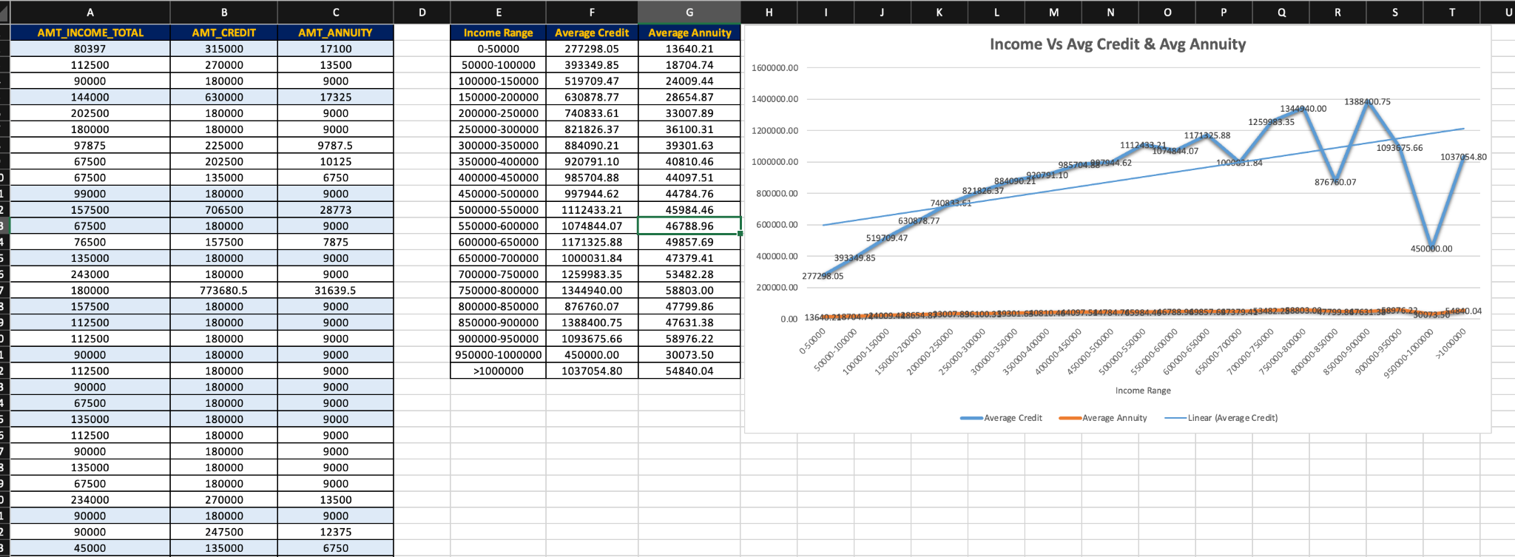
DATA ANALYTIC TASKS:
D. Perform Univariate,Segmented Univariate, and Bivariate Analysis:
BIVARIATE ANALYSIS:

Slide 16
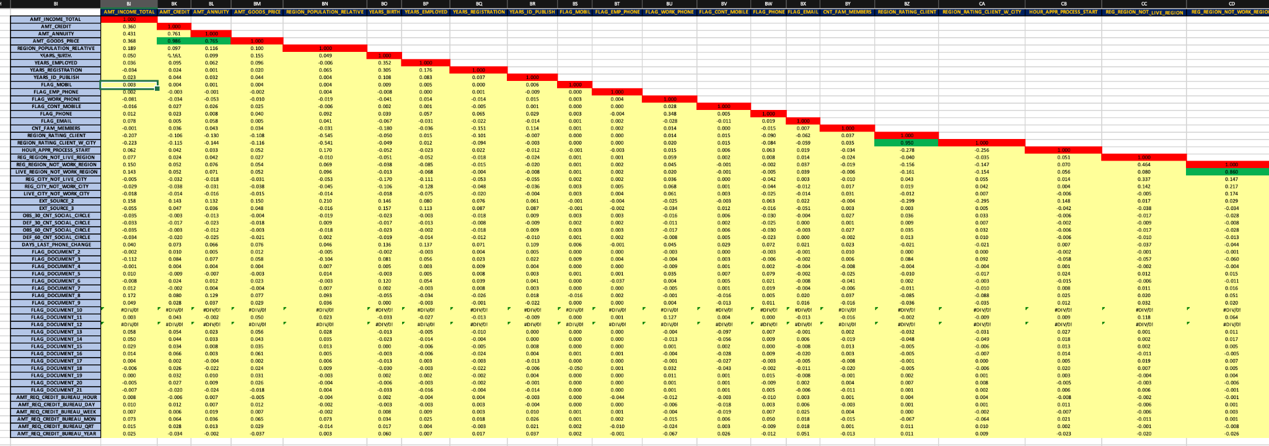
DATA ANALYTIC TASKS:
E. Identify Top Correlations for Different Scenarios:
Segment the dataset based on different scenarios (e.g., clients with payment difficulties and all other cases) and identify the top correlations for each segmented data using Excel functions.
FOR NON_DEFAULTERS:

Slide 17
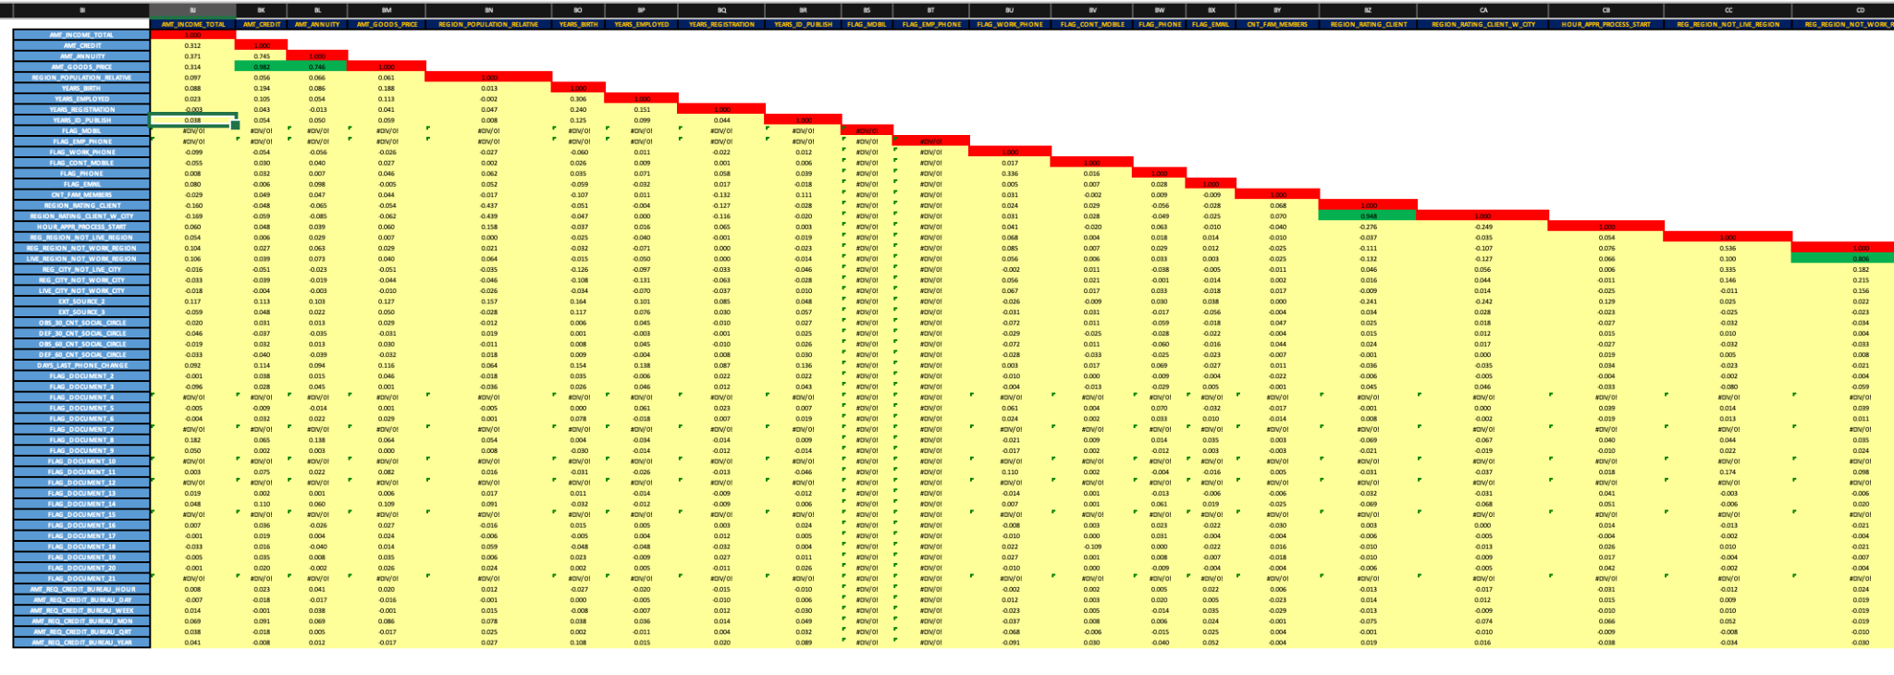
DATA ANALYTIC TASKS:
E. Identify Top Correlations for Different Scenarios:
FOR DEFAULTERS:

Slide 18
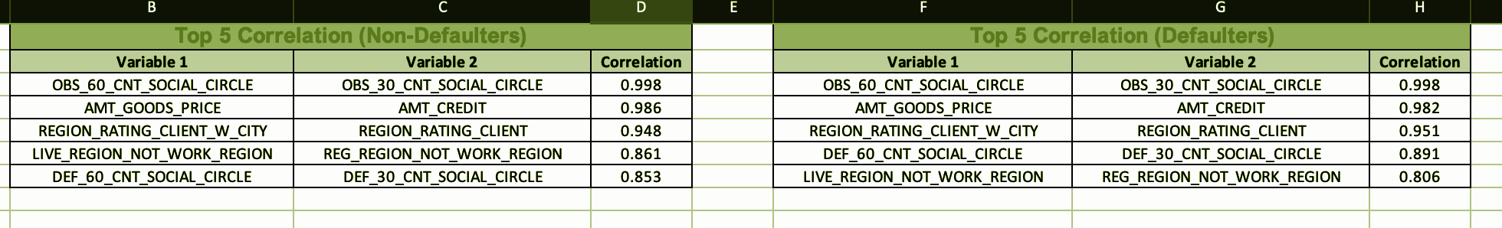
DATA ANALYTIC TASKS:
E. Identify Top Correlations for Different Scenarios:
TOP CORRELATIONS:

Slide 19
INSIGHTS:
A. Loan Approval Analysis: Analyzed the distribution of loan approvals and their correlation with applicant attributes.
B. Loan Amount Analysis: Examined the distribution of loan amounts and its impact on repayment status.
C. Credit History Analysis: Investigated the influence of credit history on loan approvals and defaults.
D. Customer Profile Analysis: Identified key customer attributes that impact loan repayment success.
E. Risk Assessment Analysis: Explored the relationship between loan defaults and risk factors such as income level and debt-to-income ratio.

Slide 20
RESULT:
By the project, I have analyzed loan application data containing customer attributes, loan amount, credit history, repayment status, and other financial factors.
I identified how each factor influences loan approvals, defaults, and financial risk assessment.
This project had a good impact on understanding the relationship between different variables in loan repayment and risk management.

Slide 21
REFERENCE LINK:
The link for excel sheet file:
EXCEL_FILE

Slide 22
THANK YOU

